Slide 1
Session 01 Getting Started (http://docs.oracle.com/javase/tutorial/getStarted/ index.html)

Slide 2
Objectives
About the Java Technology
What can Java Technology do?
How can Java support platform-independence?
Java Platform
Set up Environment Variables
The first Java program in the NetBeans
Structure of a Java program.
End users run Java Programs

Slide 3
About the Java Technology(1)
History
1990, James Gosling, Bill Joy, Patrick Naughton(Sun Microsystem) developed the Oak language for embedding programs to devices such as VCR, PDA (personal data assistant). The Oak programs require:
- Platform independent/- Extremely reliable/ - Compact
1993, interactive TV and PDA failed, Internet and Web were introduced, Sun change the Oak to an internet-development environment with a new project, named Java.
1994, the Sun’s HotJava Browser was introduced (written using Java). It showed the strength of Java applets and abilities to develop Java application.
Notes:
* Applet (n): chương trình máy tính nhỏ có thể chuyển qua internet

Slide 4
About the Java Technology(2)
History…
Embedded Systems (1991 – 1994)
A client – side Wonder (1995 – 1997)
Moved into the Middle – tier (1997 – to present)
Future: may gain more success

Slide 5
About the Java Technology(3)
The Java Programming Language is a high-level language. It’s characteristics:
Simple
Object oriented
Distributed
Multithreaded
Dynamic linking
Architecture neutral
Portable
High performance
Robust
Secure
Notes:
Architecture neutral: cấu trúc trung lập
Distributed: phân tán, có thể liên kết qua mạng internet HOẶC cũng có thể hoạt động độc lập
Portable: có thể mang đi được, di động
Robust: khỏe mạnh, thiết thực

Slide 6
What can Java Technology do?
Using Java, we can:
Development Tools.
Application Programming Interface (API).
Deployment Technologies.
User Interface Toolkits.
Integration Libraries.
Desktop Application ( Console App, GUI Apps)
Web-based Applications
Network-based Applications
Game
Distributed Applications Ứng dụng phân tán)
Embedding Application (Apps on Devices)
Notes:
Integration Librabries: hợp nhất nhiều thư viện

Slide 7
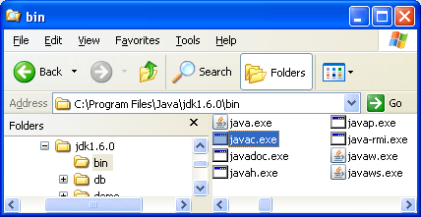
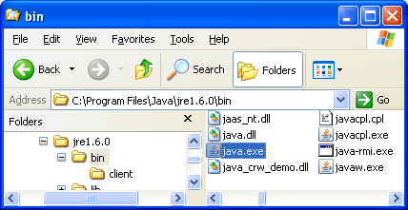
How can Java support platform-independence?
file.java (plain text)
Java Compiler
Javac.exe
Platform-Independent
Java byte-code: file.class
Java Runtime Interpreter / Java Virtual Machine (java.exe)
IBM
Macintosh
Sparc

Slide 8
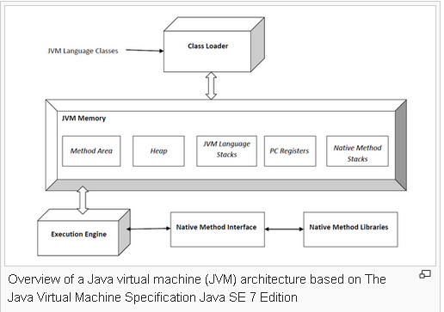
Java Virtual Machine
The Java Virtual Machine is an abstract computing machine. Like a real computing machine, it has an instruction set and manipulates various memory areas at run time. It is reasonably common to implement a programming language using a virtual machine; the best-known virtual machine may be the P-Code machine of UCSD Pascal.
http://en.wikipedia.org/wiki/Java_virtual_machine
More details:
https://docs.oracle.com/javase/specs/jvms/se8/html/jvms-1.html#jvms-1.1
Notes:
Manipulate (v): Thao tác

Slide 9
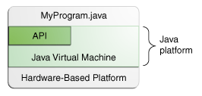
Java Platform
A platform is the hardware or software environment in which a program runs.
The Java platform has two components:
The Java Virtual Machine
The Java Application Programming Interface (API)
Operating System

Slide 10
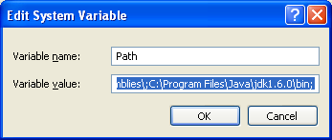
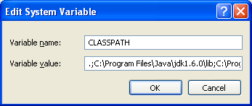
Set up Environment Variables
After installing JavaSE (Java Development Kit Standard Edition), environment variables should be setup to point to the folder in which JavaSE is installed.
Steps: My Computer/ Properties/ Advanced/Environment Variables/System Variables/ Path/ Edit
Why?
The point at the beginning of the CLASSPATH means that classes will be searched first in the current working folder.
Notes:
Path is an environment variable that specifies the location of executable files. Path specifies locations where Windows searches an application
Classpath is an environment variable that specifies the location of the class files and libraries needed for the Java compiler (javac) to compile applications

Slide 11
The first Java program in the NetBeans
This program will show the string “Hello World” to the screen.
Steps
1- Create a new Java NetBeans project
2- Add a Java class
3- Write code
4- Compile/Run the program

Slide 12
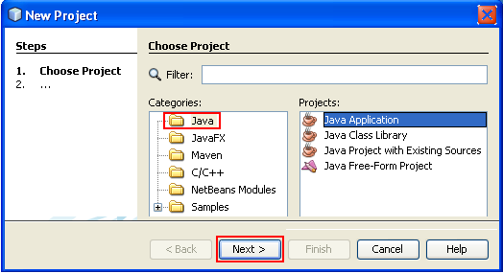

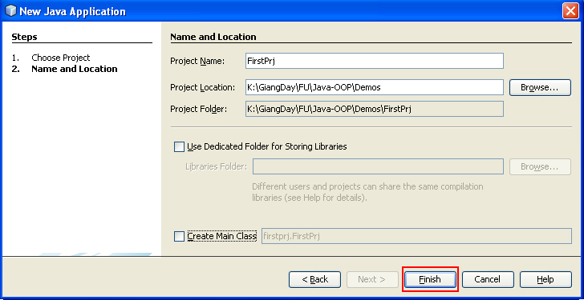
Step 1- New Project
If this option is checked, NetBeans will automatically generate a class, named Main, for the project.
If this option is not checked, we can create some programs in one project.

Slide 13
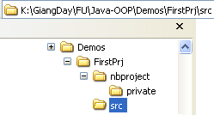
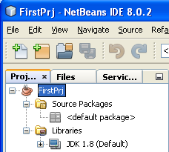
New Project…: Initial Project Structure
In Windows Explorer
In NetBeans

Slide 14
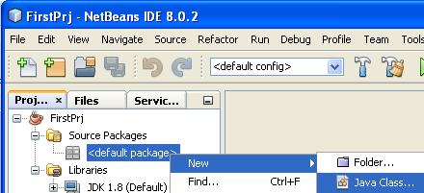
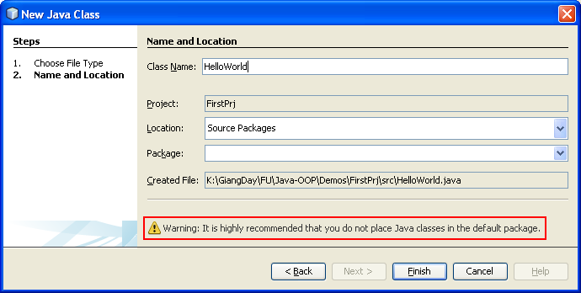
Step 2: Add a Java Class
Package: Subdirectory of the folder Project/SRC
Read
recommendation
In this demo, we do not specify package intentionally

Slide 15
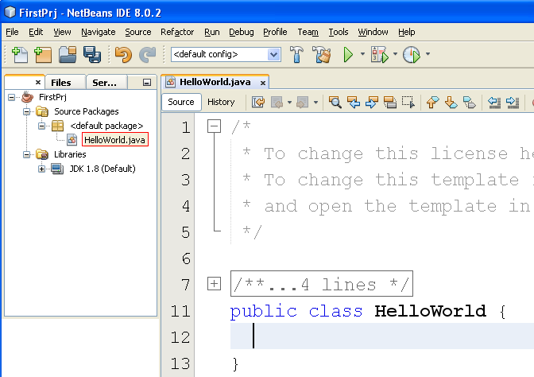
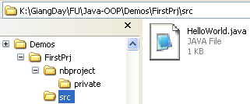
Add a Java Class…
In Windows Explorer
In NetBeans

Slide 16
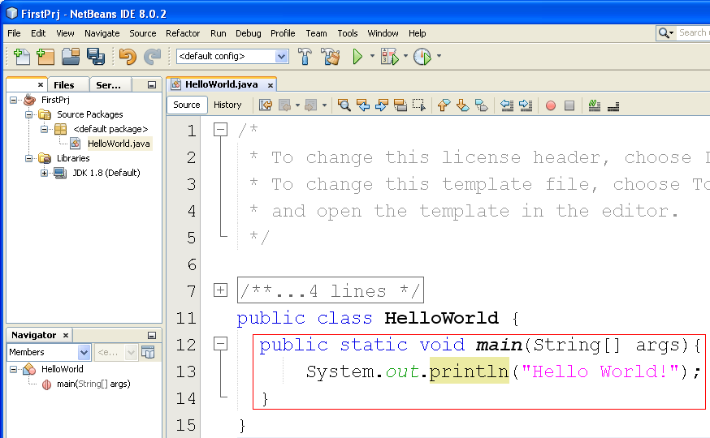
Step 3: Write code

Slide 17
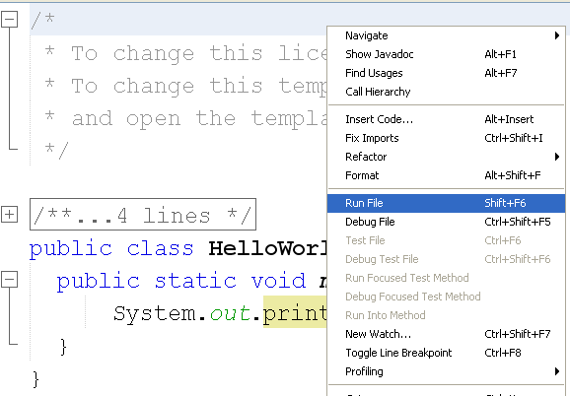
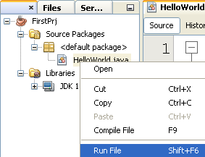
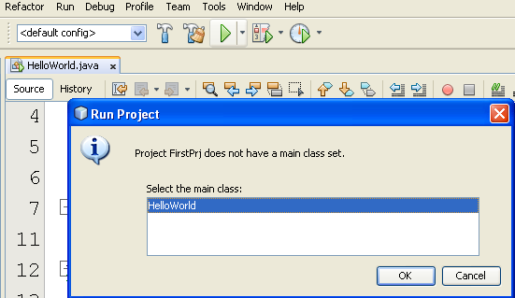
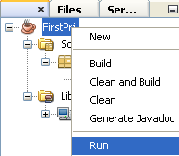
Step 4: 4 ways to Compile/Run program in NetBeans

Slide 18
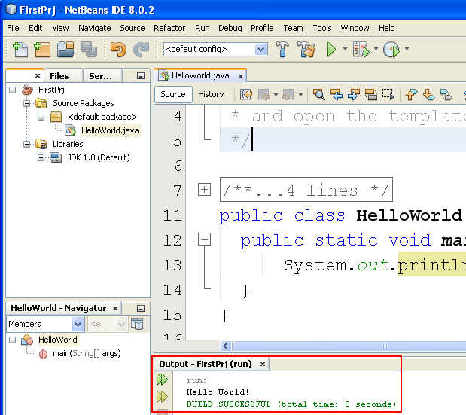
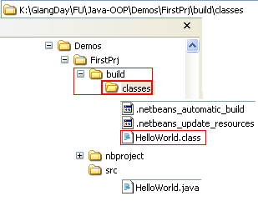
Result:

Slide 19
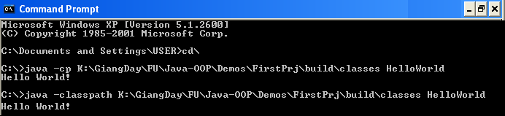
End users run Java Programs
Users can not run Java programs in NetBeans but in Java Runtime Environment (jre) installed (Java.exe) and related files
Syntax for running a Java program:
Re-try it using Helloworld, helloworld → Give comments

Slide 20
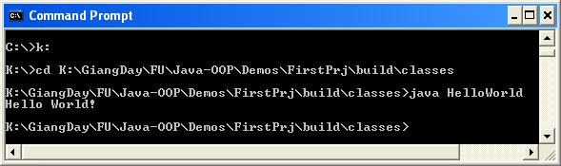
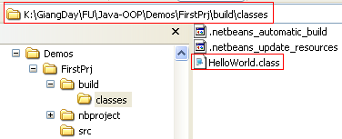
End users run Java Programs…
If the environment variable was setup with “.;”, we can run it at the working folder as:
K: Change working drive to K
cd Change working directory

Slide 21
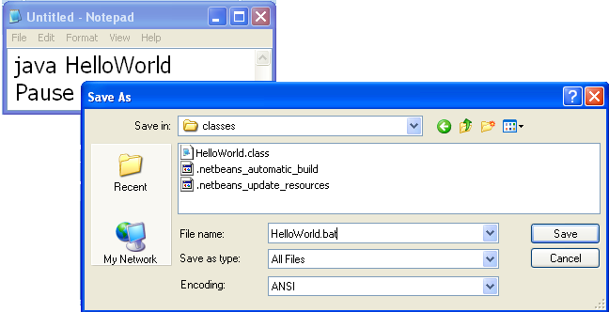
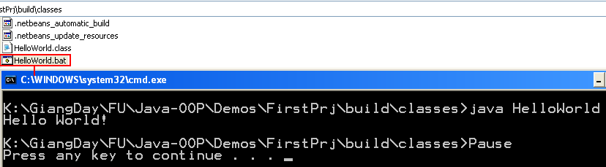
End users run Java Programs…
Developer should support end users an easier way to run the program: a BAT file

Slide 22


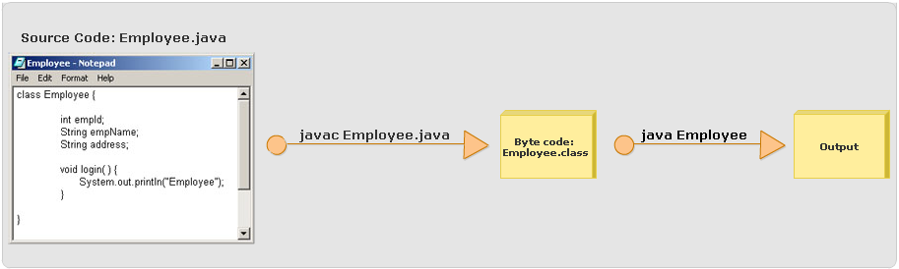
Explain JDK and its tools
javac (Java compiler)
java (Java interpreter)

Slide 23
A Closer Look at the "Hello World!" Application
Comments
Traditional /*this is a comment*/
Comment to line end //this is an end of line comment
Class declaration
public class ClassName { ... }
For example: public class HelloWord { ... }
The main Method – Entry point of Java program
public static void main(String[] args) {..}
public and static can be written in either order
The main method accepts a single argument: an array of elements of type String. A demonstration for passing strings to the main method will be presented in the next session.
Notes:
The main method accepts a single argument: an array of elements of type String.
public static void main(String[] args)
This array is the mechanism through which the runtime system passes information to your application. For example:
java MyApp arg1 arg2
Each string in the array is called a command-line argument. Command-line arguments let users affect the operation of the application without recompiling it. For example, a sorting program might allow the user to specify that the data be sorted in descending order with this command-line argument:
-descending

Slide 24
Common Problems (and Their Solutions)
Compiler Problems
'javac' is not recognized as an internal or external command, operable program or batch file
->Updating the PATH variable in the JDK
Syntax Errors (All Platforms)
Semantic Errors
Runtime Problems
Exception in thread "main" java.lang.NoClassDefFoundError
Could not find or load main class HelloWorld.class
Classname is incorrect

Slide 25
Try and Explore
Change | To – If no error, try run it
public class HelloWorld | public class HelloWorld2
public class HelloWorld | class HelloWorld2
public static void main(String[] args) | public static void main(String args[])
public static void main(String[] args) | public void main(String[] args)
public static void main(String[] args) | void main(String[] args)

Slide 26
Summary
An overview of Java technology as a whole.
What to download, what to install, and what to type, for creating a simple "Hello World!" application.
Discusses the "Hello World!" application.
Trouble compiling or running the programs.
Notes:
(*) JDK → JRE → JVM
[files .java → files .class → JVM (Java Vitural Machine) ]

